Slide 1


Implementation and comparison of gender
classification models
Dataset: IMDB-WIKI face images
Team Members:
Savith Jayasekera
Oscar Chen
Prince Okoli
ENSF 619.25
Machine Learning-Winter 2019
Notes:
This presentation in mandatory for all of the team, No presentation = 0% (Project)
The presentation length should be EXACTLY 150 seconds (2.5 minutes)
Please do not change the fonts!
Presentation time: April 1st , from 2:00 to 3:15pm, BI 587

Slide 2
Motivation
Why the need for the comparison?
How good is SVM for image classification?
How about Convolutional Neural Networks
ENSF 619.25
Machine Learning-Winter 2019

Slide 3
Methodology
Methodology
How good is SVM for image classification?
Radial basis function kernel
Convolutional Neural Network (CNN):
Trial and error on small datasets
Simple architecture
More complex architecture
ENSF 619.25
Machine Learning-Winter 2019

Slide 4
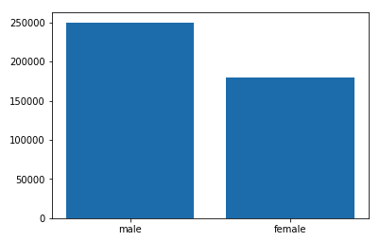
Preprocessing
Preprocessing: parse Matlab database to Pandas dataframe
Produce smaller datasets for early trials
OpenCV: tensorize images
Tensorflow: create data generators for batch streaming
ENSF 619.25
Machine Learning-Winter 2019

Slide 5
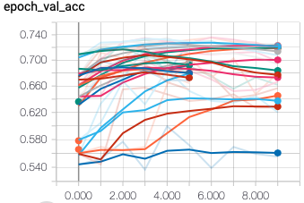
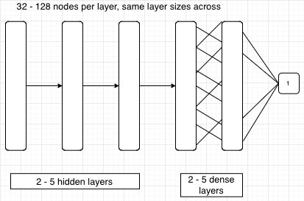
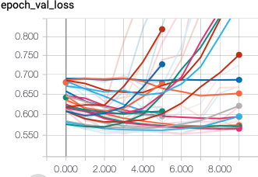
Learning experiment
Deep learning – Simple CNN on 1-5% data sets
ENSF 619.25
Machine Learning-Winter 2019

Slide 6
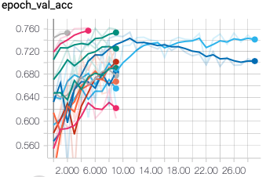
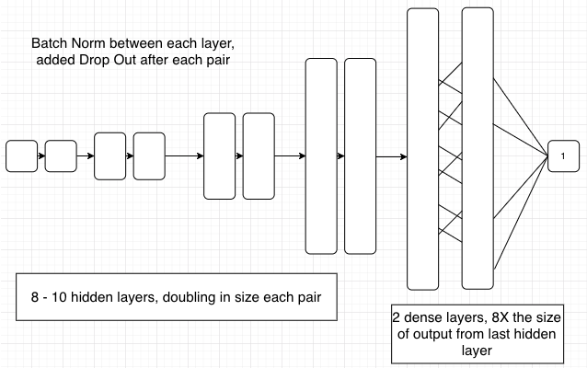
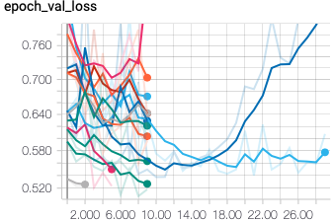
Learning experiment
Deep learning: More complex CNNs on 10% datasets
ENSF 619.25
Machine Learning-Winter 2019

Slide 7
Learning experiment
Traditional machine learning:
Support Vector Machine (SVM)
Binary Logistic regression (Logit)
Linear discriminant analysis (LDA)
ENSF 619.25
Machine Learning-Winter 2019

Slide 8
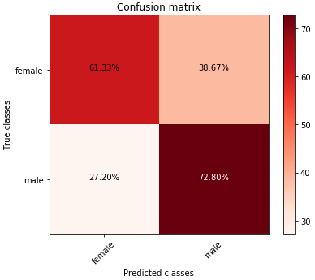
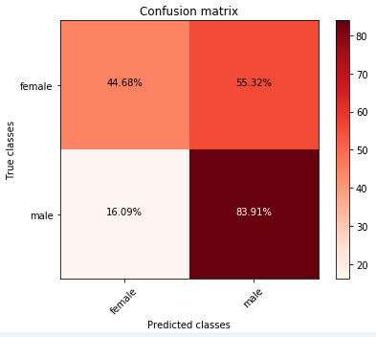
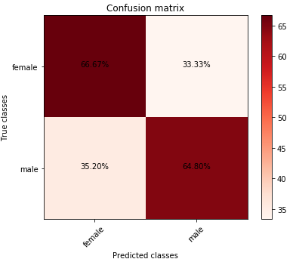
Learning experiment
LDA: 66%
SVM: 66%
Logit: 69%
ENSF 619.25
Machine Learning-Winter 2019

Slide 9
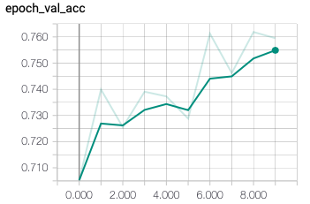
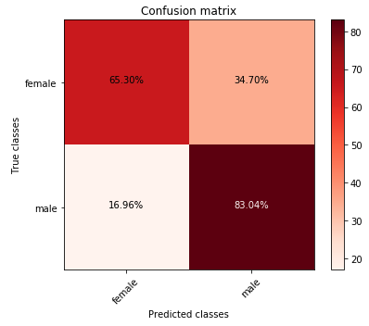
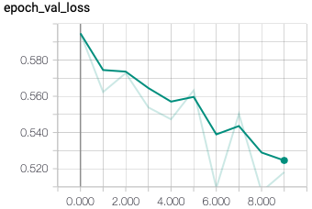
Learning experiment
CNN after 10 epochs: 75%
(still improving)
ENSF 619.25
Machine Learning-Winter 2019

Slide 10
Results and Conclusion
Final Results
CNN performes much better with room to improve.
Most models performed better on male than female due to sample bias.
CNN training requires large dataset than traditional methods and can take much longer.
ENSF 619.25
Machine Learning-Winter 2019

